Slide 1
Peterlee Magistrates’ Court

Slide 2
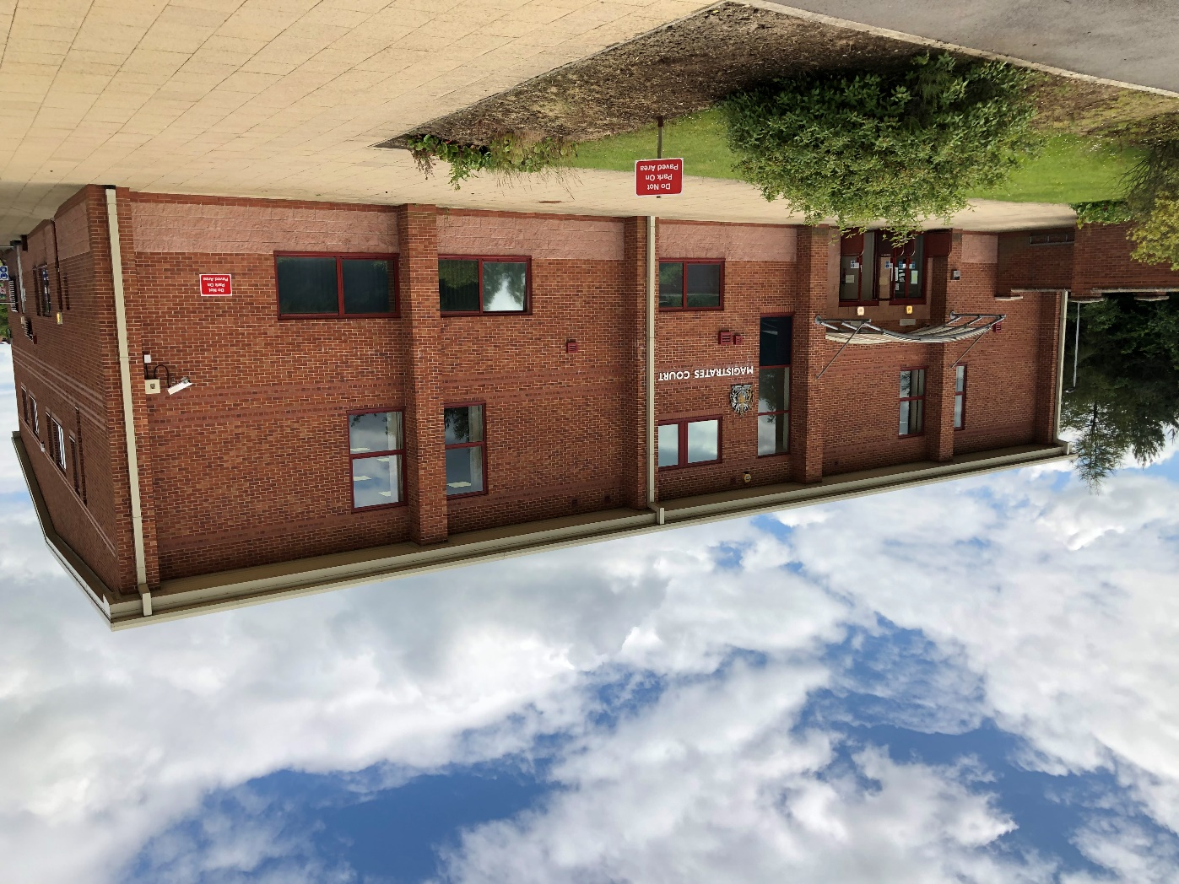
Outside the court

Slide 3
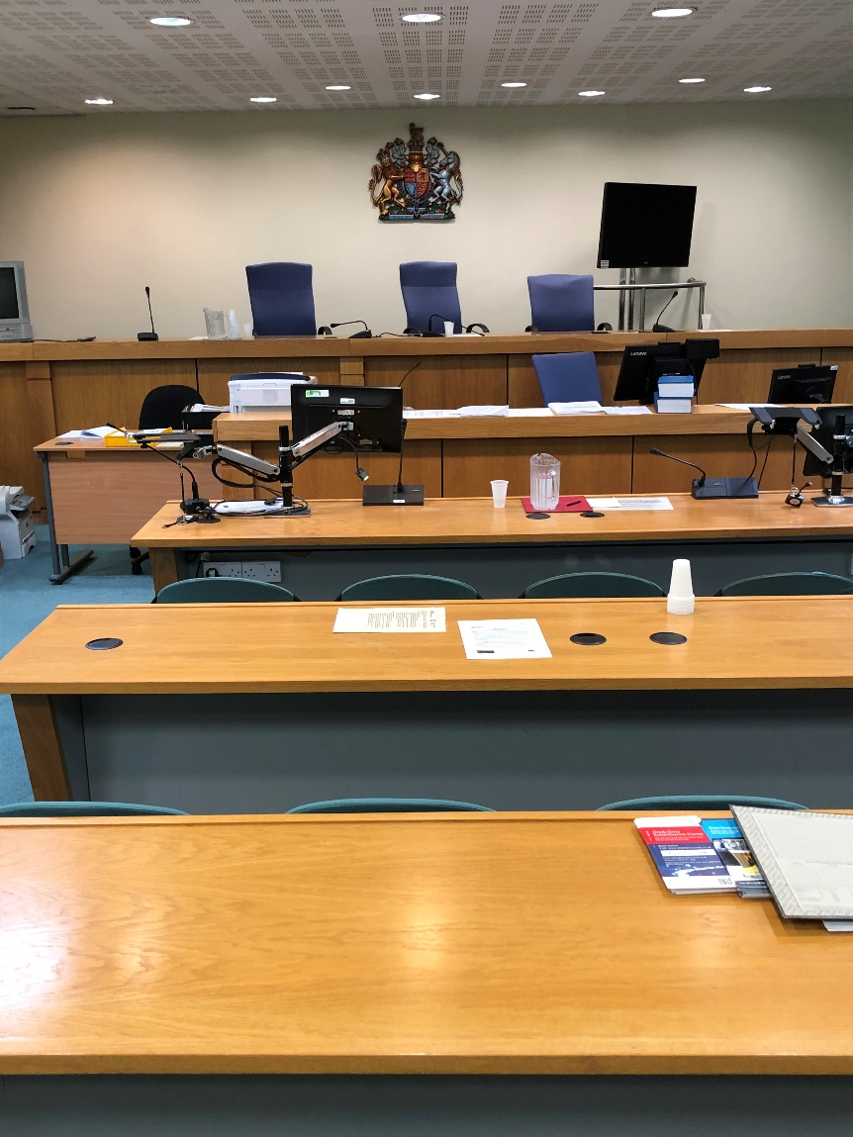
Inside one court room

Slide 4
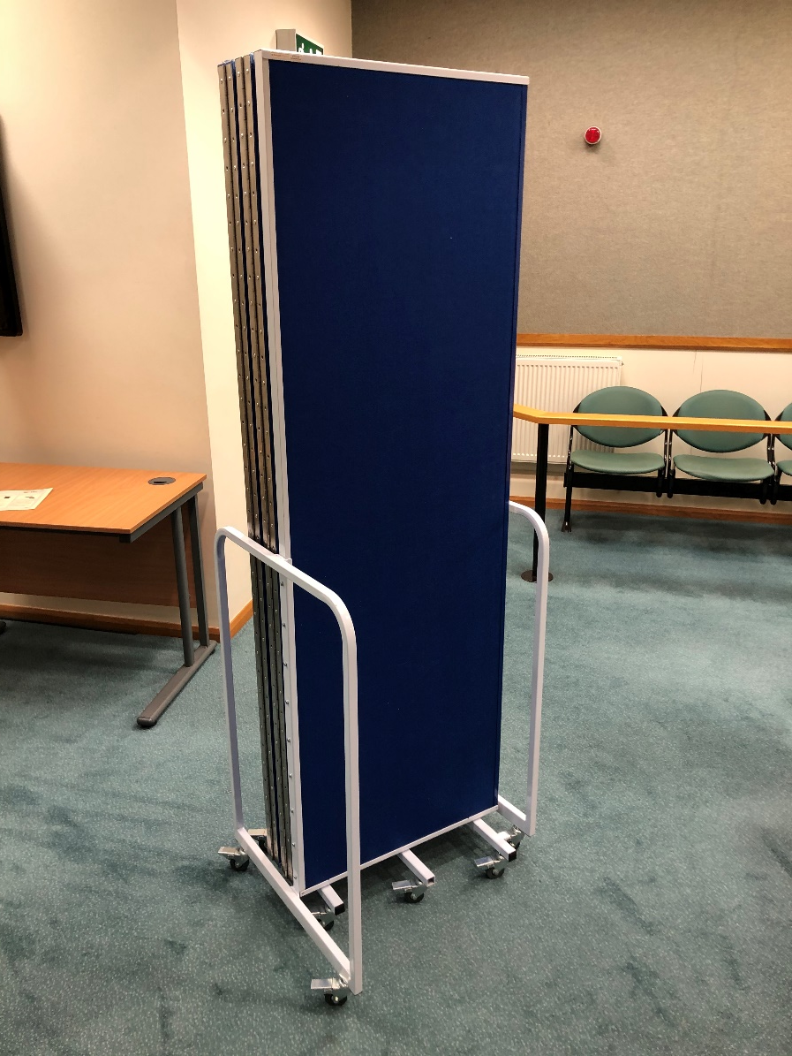
Special Measures: Screens
The screen(s)

Slide 5
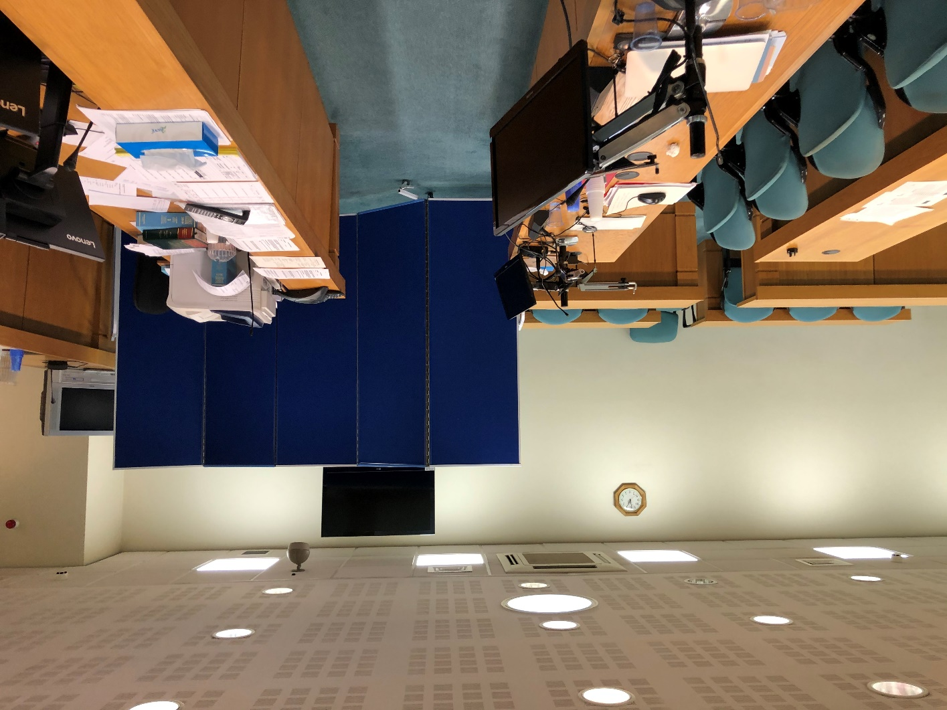
Special Measures: Screens
What the defendant sees when the screen is used

Slide 6
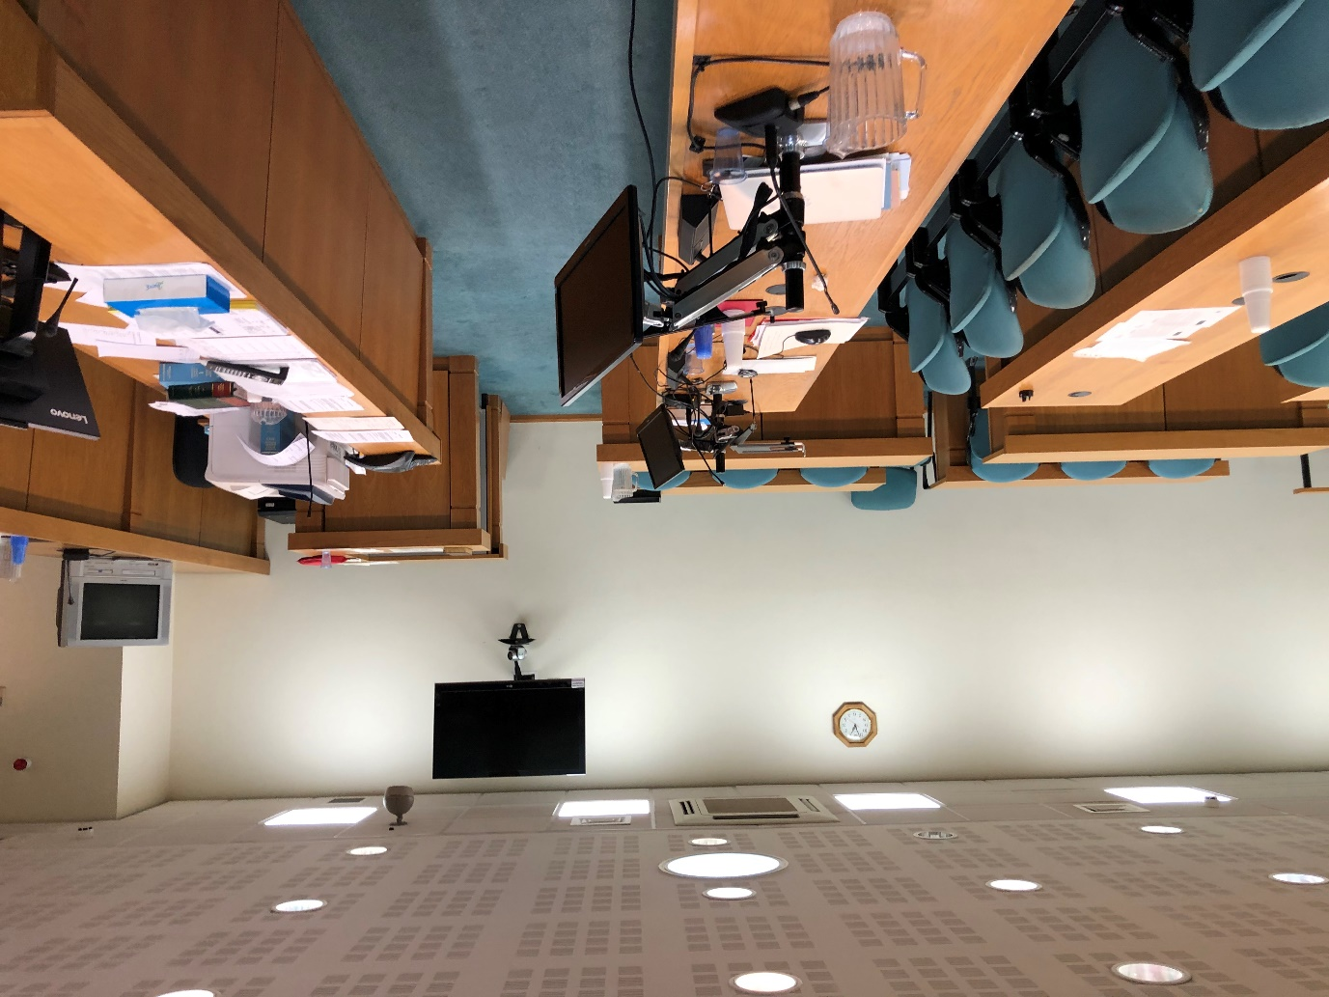
Special Measures: Screens
What the defendant sees when the screen is not used

Slide 7
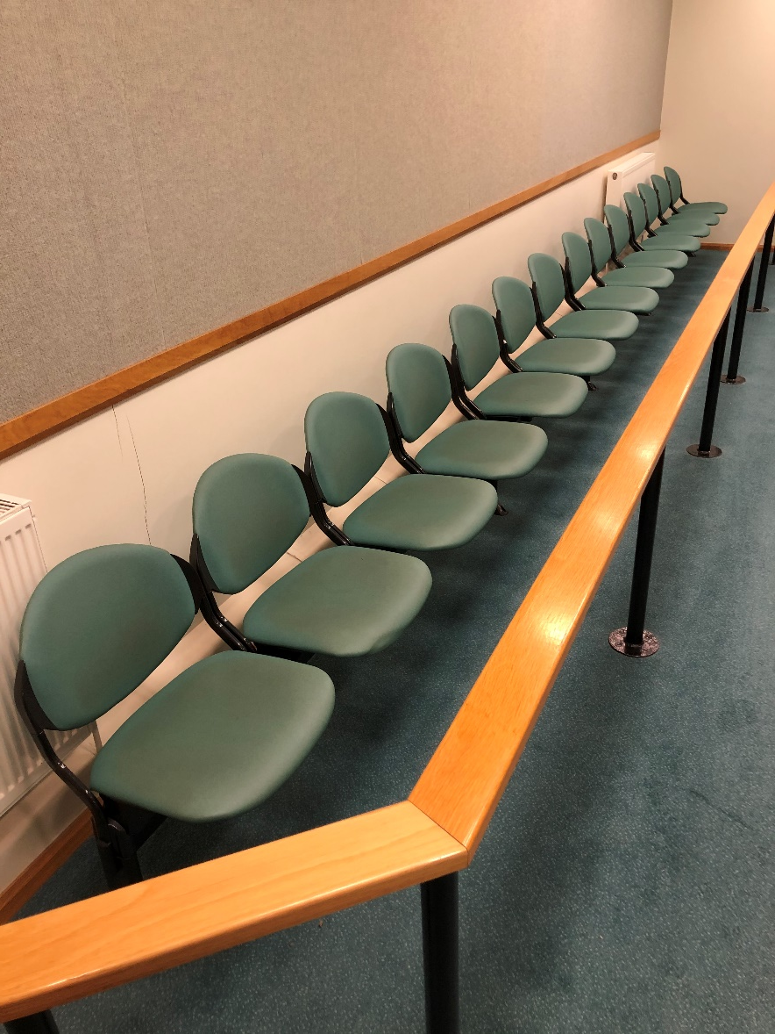
Special Measures: Stopping some people being in court
The public gallery

Slide 8
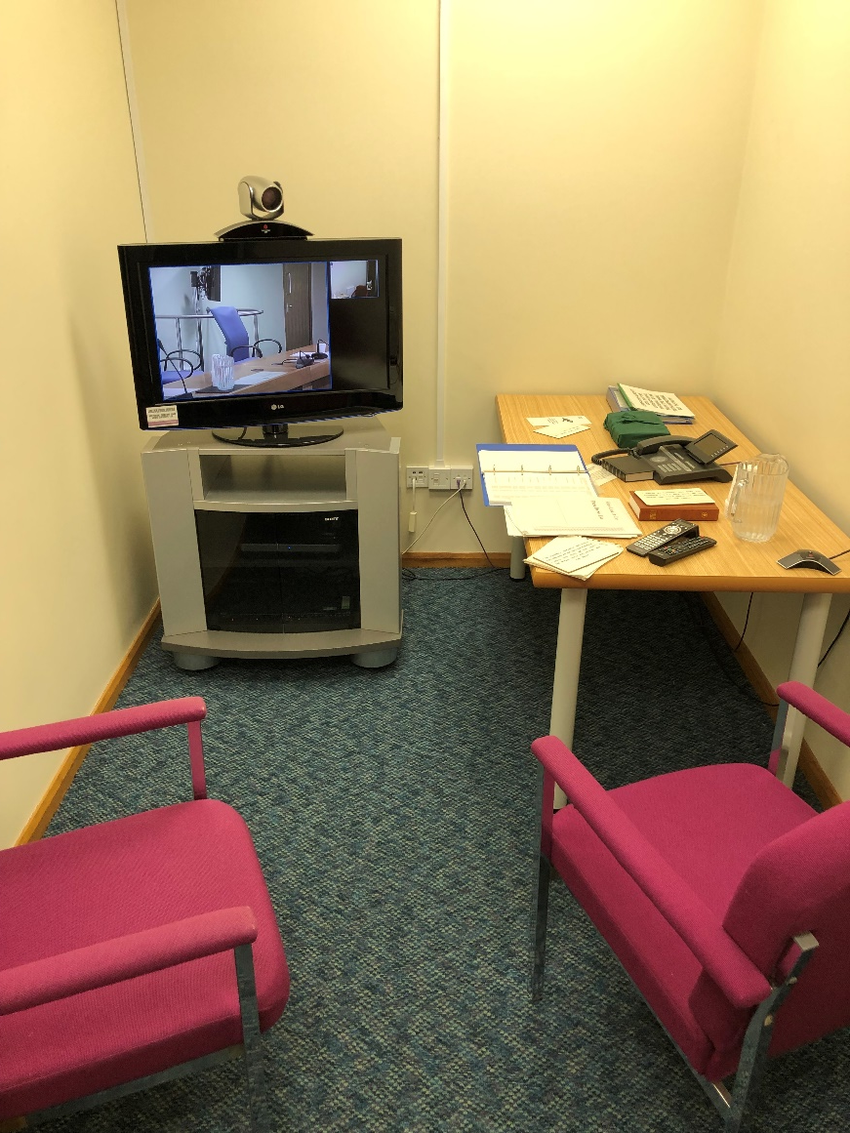
Special measures: Using the ‘live link’

Slide 9
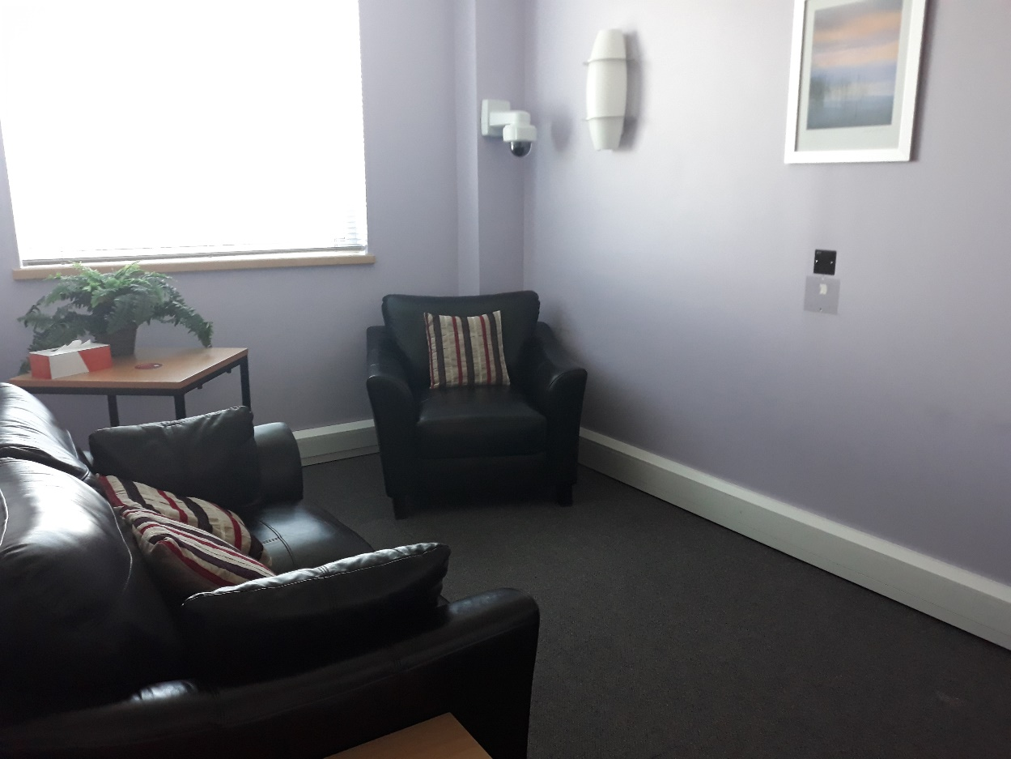
Special measures: Showing the police recorded interview
A room used for police interviews

Slide 10
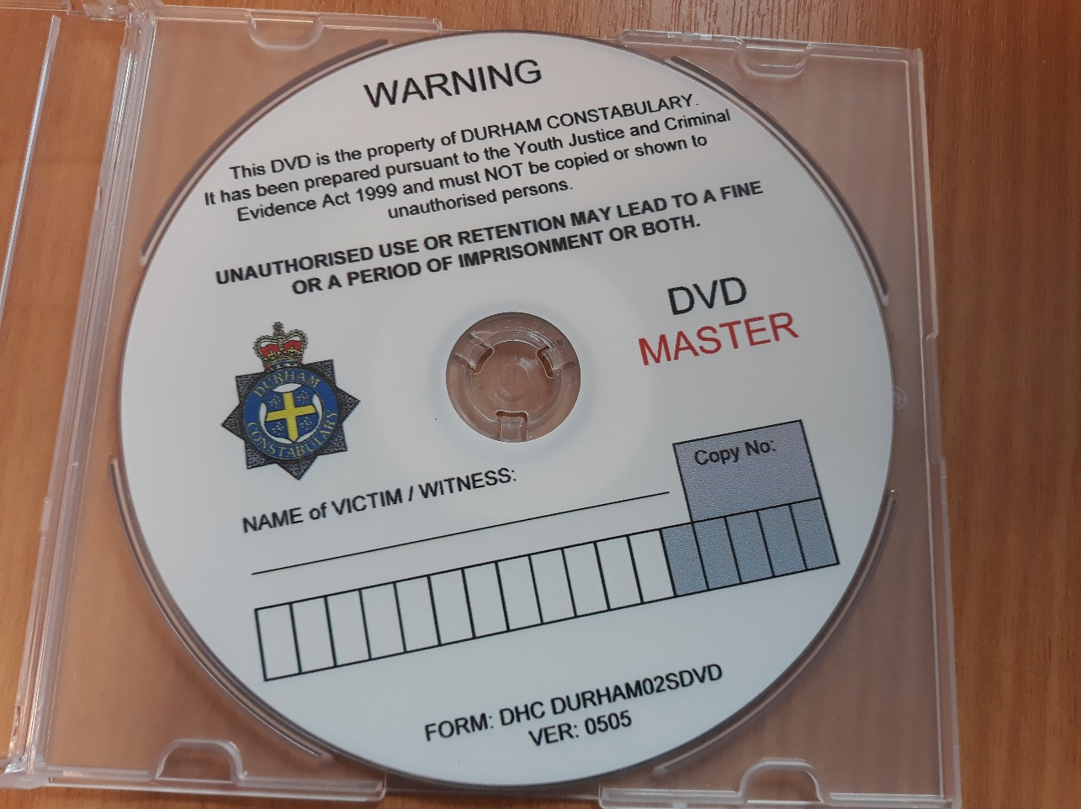
Special measures: Showing the police recorded interview
A police DVD disc used for police interviews

Slide 11
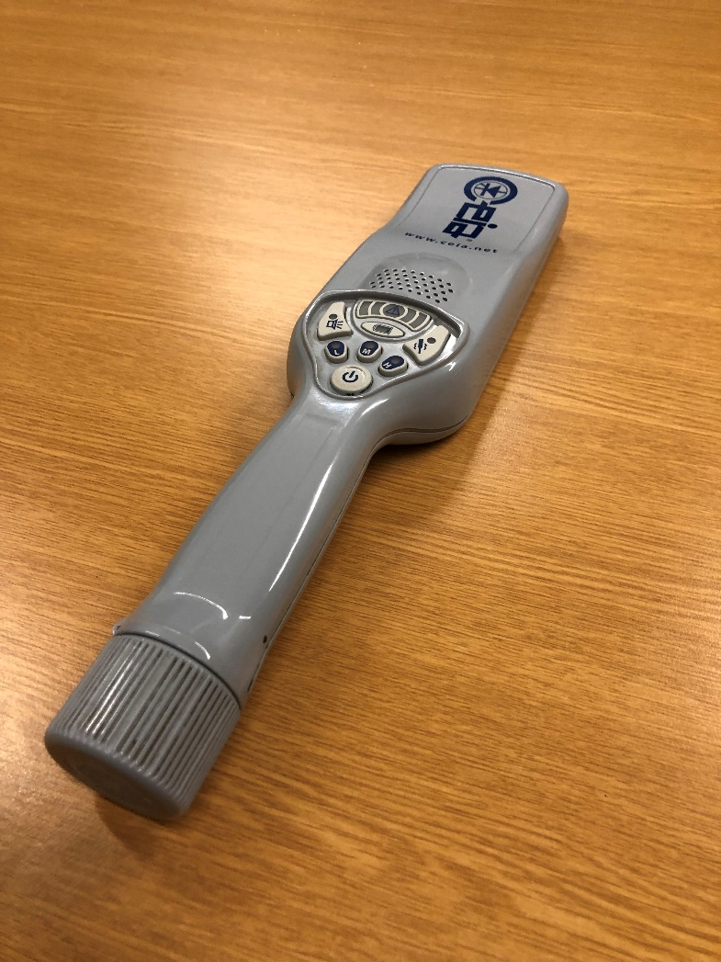
The small security scanner

Slide 12
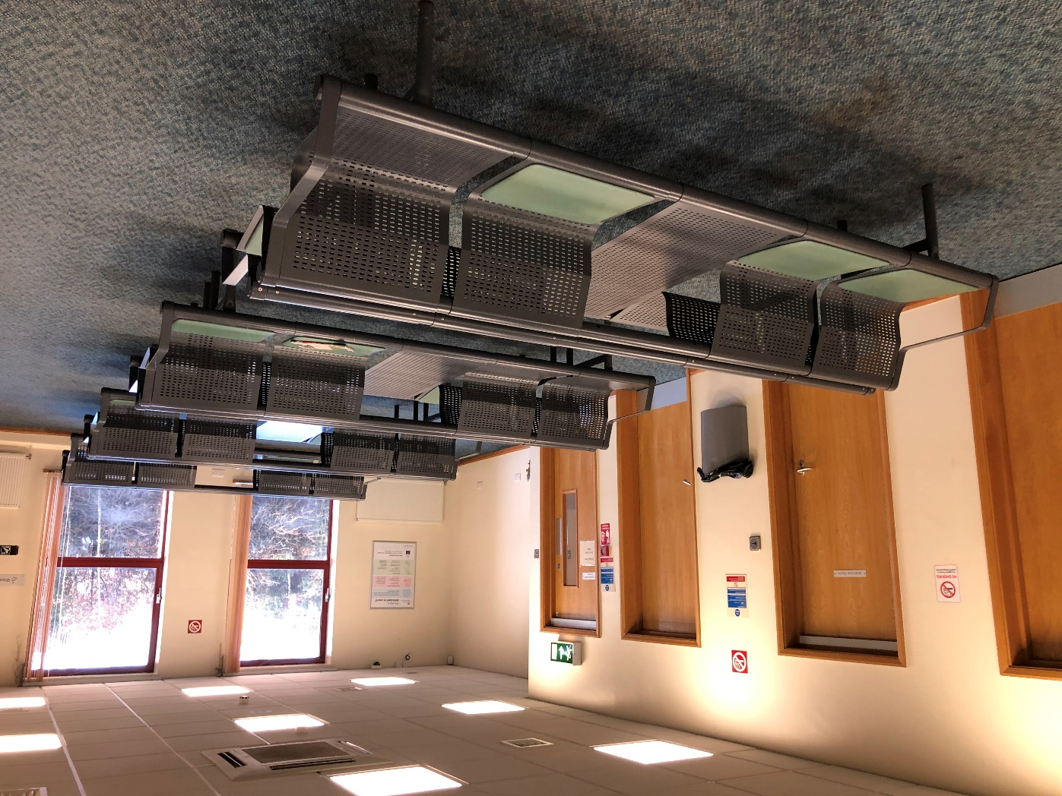
The general waiting area inside the court building

Slide 13
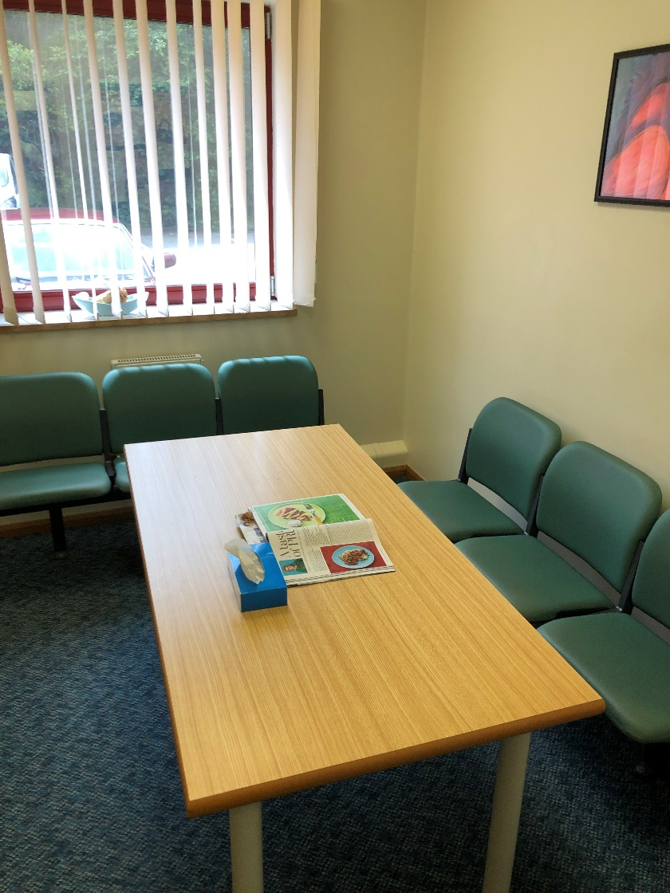
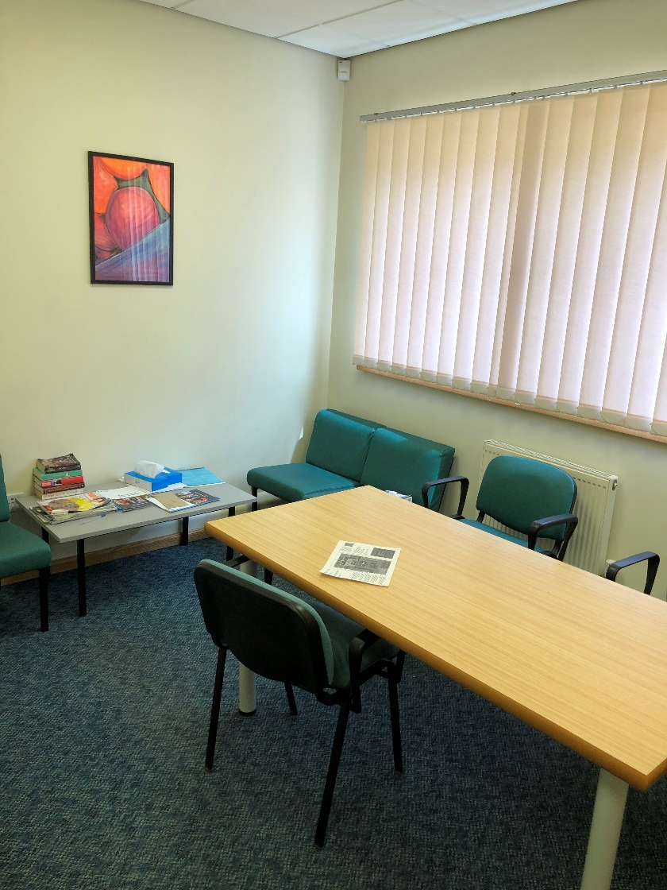
A waiting room for witnesses

Slide 14

Walking into one courtroom

Slide 15
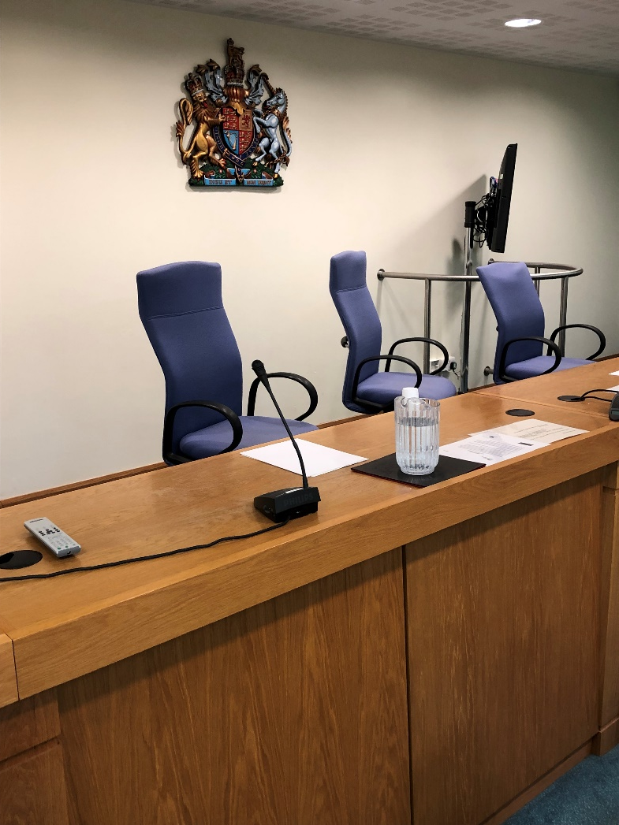
What you see from this witness box

Slide 16
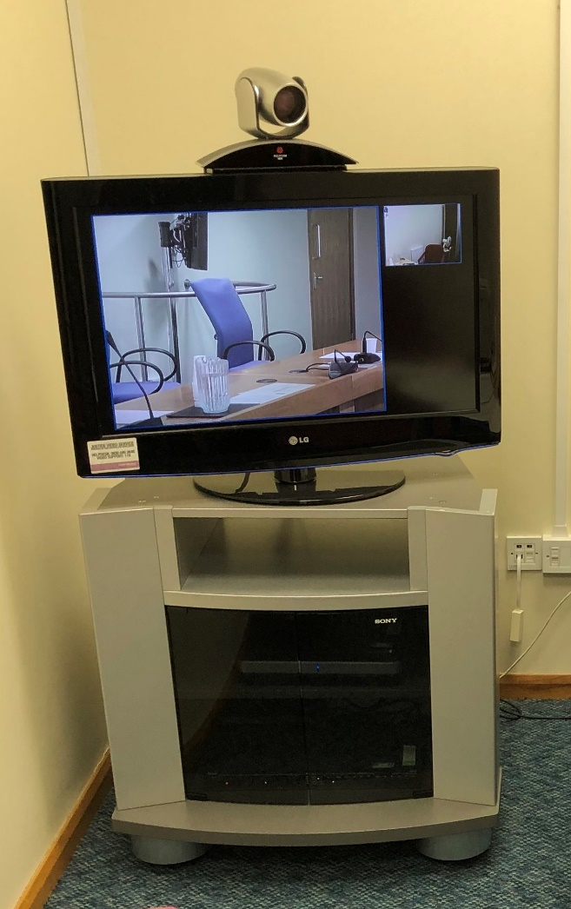
Using the ‘live link’ to answer questions
The TV in the live link room

Slide 17
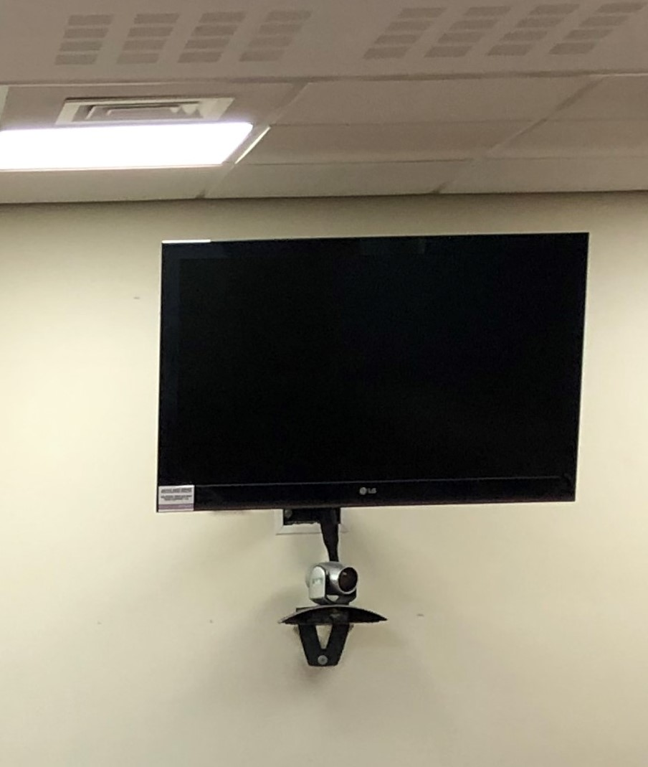
Using the ‘live link’ to answer questions
A court room TV

Slide 18
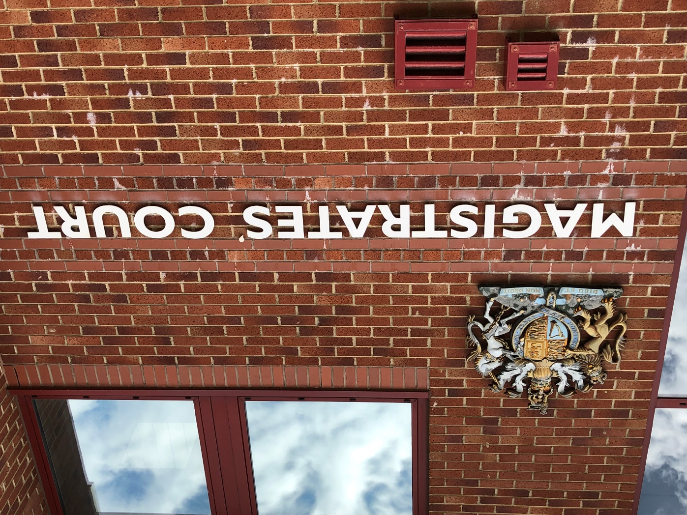
The court crest

